Slide 1
Business Planning for Dorothy -Analysis for Coffee shop start-up
May 2020

Slide 2
Business Analysis for coffee shop start-up around Melbourne Uni
1
Dorothy, one of my best friends, wants to open up a coffee shop around Melbourne university or near the Melbourne City Centre.
2
Dorothy want to make a through analysis before she started to open the coffee shop.
3
Not only Dorothy, for other people who want to open a coffee shop around Melbourne Uni or Melbourne Centre would be interested in the content listed in the report as well.

Slide 3
Data Source Clarifying
Source: Foursquare
30
19
3
Coffee Shops
Coffee Shops
Trending venue
Around Melbourne Uni
For further analysis

Slide 4
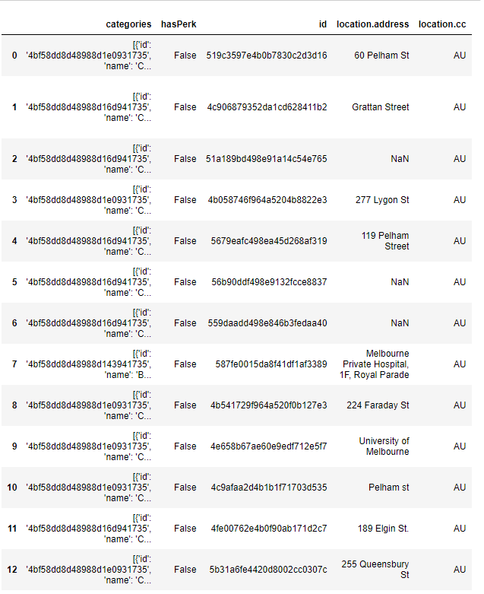
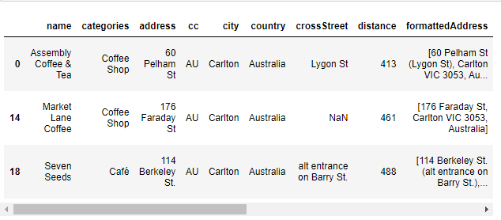
Data Observation
1 Coffee shops around Melbourne Uni
2 Check coffee shops located in Carlton to narrow down analysis scope
Narrowing down to coffee shops locates in Carlton, we get a data frame with three coffee shops. They are ‘Assembly Coffee & Tea’,’ Market Lane Coffee’,’ Seven Seeds.
We get a data frame including 19 coffee shops around Melbourne Uni

Slide 5
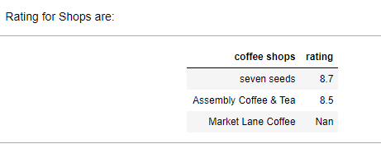
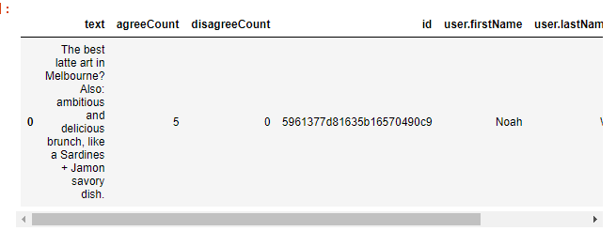
Data Observation
3 rating analysis
4 Tips analysis for Seven Seeds
For seven seeds gets the highest rating, we dig further for the tips analysis.

Slide 6
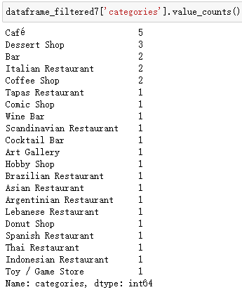
Data Observation
5 Trending analysis around Melbourne Uni and Melbourne Centre
Of the 30 trending venues listed, 7 of them are coffee or café related, demonstrating that coffee is still popular and of bright future.

Slide 7
Conclusion
Coffee Shop worth starting
Coffee is not enough
coffee shop is worth for investing. Dorothy could start her business around Melbourne Uni or locate near Melbourne Centre both, but Melbourne Centre more is preferable for it has clear upside trending.
For a coffee shop, Dorothy should not only focus on the taste of coffee or coffee beans itself, but also pay more attention on decorations or other food provided like the quality of brunch provide. As demonstrated by the Seven seeds, people come to there probably just because of the artist decoration, not just for special coffee taste.

Slide 8
Thanks

